Slide 1
Bioinformatics: transcriptome analysis
🐯
🐞
👽
Greg Gloor
Department of Biochemistry
University of Western Ontario
https://github.com/ggloor/compositions/presentations

Slide 2
BV dataset
🐯
🐞
👽
What assumptions do not fit?
Majority invariant
Dispersion ~ abundance
Data are centered
Model as NB or ZIG
zero == zero
Counts
Notes:
Breaks the assumptions
Note the midpoint of the dataset is off the 0 line

Slide 3
Not one dataset
edgeR
Selex dataset
The vast bulk of features do not change in this experiment
Both DESeq2 and edgeR get it almost but not quite exactly wrong

Slide 4
Why sequence stuff
Fame? 🏆
Money? 💰
Ennui? 👻
Curiosity? 🧠
🐯
🐞
👽

Slide 5
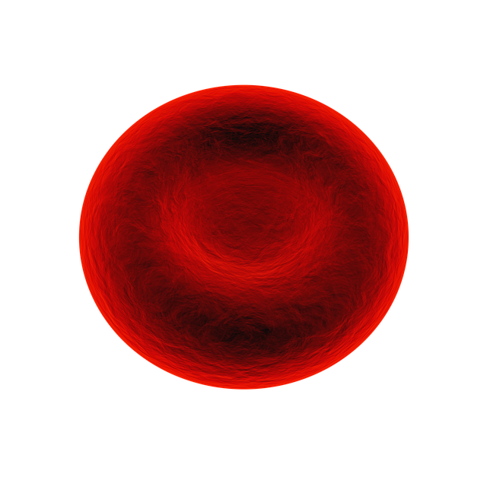
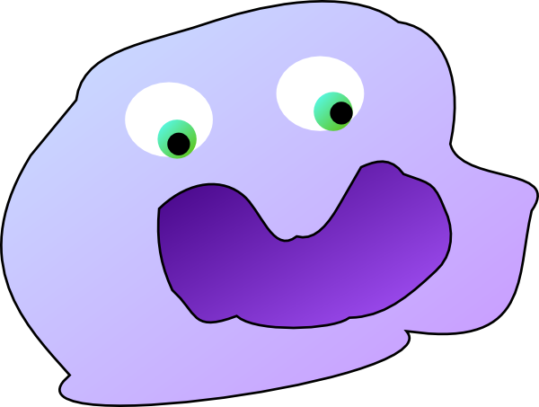
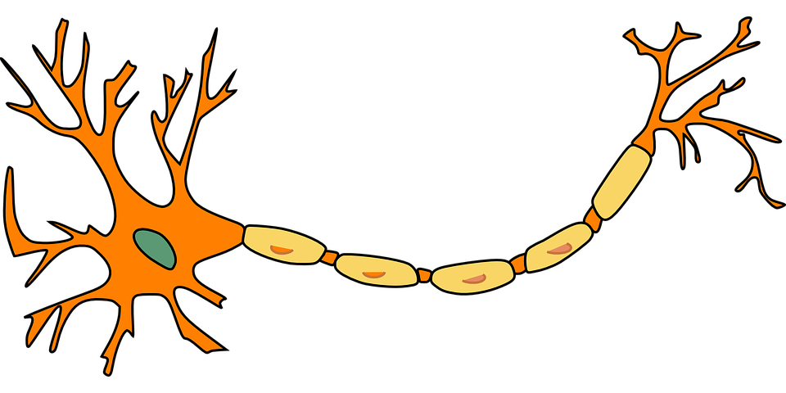
Why sequence stuff?
Fame? 🏆
Money? 💰
Ennui ? 👻
Curiosity? 🧠
I hope it is because we want to understand the environment
🐯
🐞
👽

Slide 6
The sequencing meat grinder
🐯
🐞
👽
What assumptions do not fit?
Counts
Majority invariant
Dispersion ~ abundance
Model as NB or ZIG
Correlation

Slide 7
Normalization is statistical malpractice
🐯
🐞
👽
Prop | Size | moe.form | Dir.moe | Norm.size | Norm.moe
0.2 | 1000 | 0.025 | 0.024 | 479.8 | 0.036
0.2 | 100 | 0.078 | 0.072 | 479.8 | 0.036
0.25 | 250 | 0.054 | 0.052 | 440.4 | 0.040
0.19 | 2000 | 0.017 | 0.017 | 488.5 | 0.035

Slide 8
Normalization is statistical malpractice
🐯
🐞
👽
Prop | Size | moe.form | Dir.moe | Norm.size | Norm.moe
0.2 | 1000 | 0.025 | 0.024 | 479.8 | 0.036
0.2 | 100 | 0.078 | 0.072 | 479.8 | 0.036
0.25 | 250 | 0.054 | 0.052 | 440.4 | 0.040
0.19 | 2000 | 0.017 | 0.017 | 488.5 | 0.035
If bioinformaticians were political pollsters we would be sued by our clients

Slide 9
Probabilistic read mapping of technical replicates with salmon

Slide 10
Sequencing is random sampling
🐯
🐞
👽
Notes:
Starting with a of molecules composed of Tigers and Ladybugs
We take a random sample, how many Tigers and how many Ladybugs
If we count a given random area we can infer how many off each there are in entire set

Slide 11
Sequencing is random sampling
🐯
🐞
👽
Notes:
Starting with a of molecules composed of Tigers and Ladybugs
We take a random sample, how many Tigers and how many Ladybugs
If we count a given random area we can infer how many off each there are in entire set

Slide 12
Random data as counts
🐯
🐞
👽
Example 100 random sample sets
range=1800-2200
range= 8000-12000
range=450-550
🐯
🐞
👽

Slide 13
Same random data as proportions
🐯
🐞
👽
Constant sum of 1000
Constant sum operations:
Sequencing
percentage, relative abundance, probability, proportion
Count normalization
Rarefaction
Gloor, et al. 2016. Ann Epidemiology
Gloor, et al. 2016. Can J. Micro.
Gloor, et al, 2017. Front. Micro.

Slide 14
Normalization is no help at all
🐯
🐞
👽
Once data are on the simplex, they cannot be recovered without
⌛️ 💲 🏋🏼‍

Slide 15
CoDa properties and *lr
Count
Sequencing
Simplex
🐯
🐞
👽
27
853
66
740
112
216
Simplex: one fewer dimensions than variables
Problems remain regardless of dimension
*lr(x) = [ log(x₁/g_{X}), log(x₂/g_{X}), … log(x_{D}/g_{X}) ]
X = [ x₁, x₂, … x_{D} ], g_{X} = geometric mean of X (or subset)
Probabilities
Some invariant
Relative values
Multivariate Poisson
Aitchison 1986. Stat. Anal. Comp Data
Pawlowsky-Glahn, 2015. Mod. Anal. CoDa
Notes:
Scale dependence - hence ‘normalization’
Correlation and covariation are unreliable
Addition and subtraction are not useful operations
Subsetting and aggregating are problematic
Sparse data is an issue

Slide 16
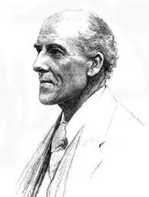
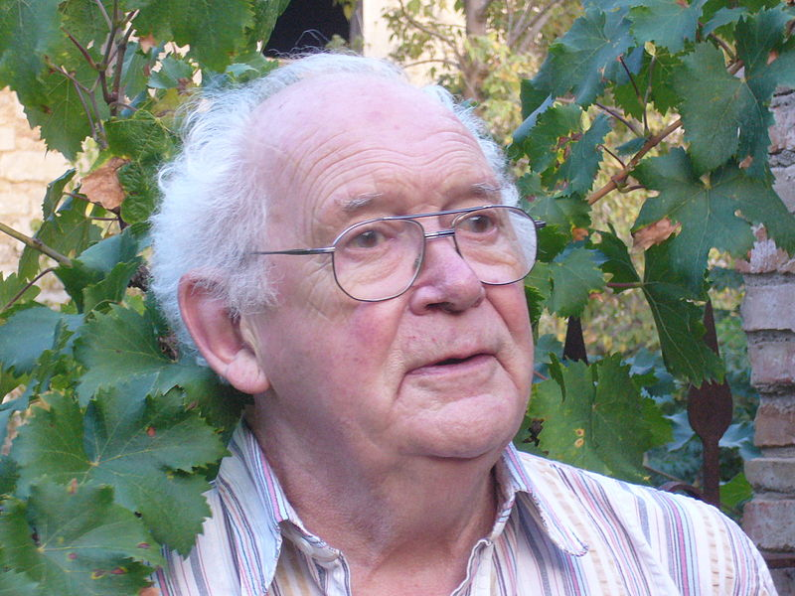
We have CoDa
🐯
🐞
👽
Compositional data are logically inconsistent with most tools in common use (Pearson 1897)
correlation, PCA etc.
Sequencing, negative binomial, rarefaction, ZIG
Work in log ratios
Aitchison and others
Conceptually similar to qPCR
Aitchison 1986

Slide 17
Correlation in CoDa
spurious correlation
Correlation observed is not the same for the numerical and proportional data
or for a subset of that data
Whenever any two variables share a common index (or have a constant sum). (Pearson 1897)
Correlation in these data must maintain a constant ratio
Pearson correlation with an intercept of 0 (RA), or linear line with a slope of 1 (log-ratio) (Lovell 2015, Erb 2017)
🐯
🐞
👽

Slide 18
Learn to love (tolerate) the simplex
 | T | A | L
x1 | 10 | 20 | 70
x2 | 20 | 10 | 70
x3 | 30 | 40 | 30
x4 | 40 | 30 | 30
🐯
🐞
👽
👽
S scale invariant
P perturbation invariant
D subcompositionally dominant
Operations
Addition: 50% + 50%
Subtraction: 50% - 50%?
Perturbation: 50% x 50% = ?
Powering: 50%^3 = ?
🐞
🐯

Slide 19
Learn to love (tolerate) the simplex
 | T | A | L
x1 | 10 | 10 | 70
x2 | 20 | 10 | 70
x3 | 30 | 40 | 30
x4 | 40 | 30 | 30
🐯
🐞
👽
👽
S scale invariant
P perturbation invariant
D subcompositionally dominant
Operations
Why not 50% - 50%?
Perturbation: 50% x 50% = ?
Powering: 50%^3 = ?
🐞
🐯

Slide 20
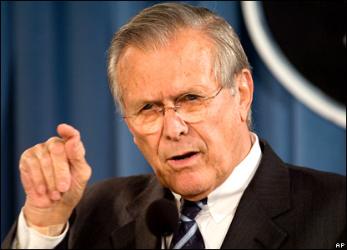
To sum up
🐯
🐞
👽
There are known knowns. These are things we know that we know.
There are known unknowns. That is to say, there are things that we know we don't know.
But there are also unknown unknowns. There are things we don't know we don't know.
There are unknown knowns. These are things we think we know that we actually don’t know.

Slide 21
Available tools
🐯
🐞
👽
Outliers & filters
CoDaSeq (github.com/ggloor)
Exploratory data analysis
Compositional biplots (compostions - CRAN)
omicplotR (Dan Giguere: github.com/dgiguer/omicplotR/wiki)
philr (Bioconductor)
Differential abundance
ALDEx2 (Bioconductor)
selbal (github.com/UVic-omics/selbal)
ANCOM (QIIME)
Compositional association
propr (CRAN)

Slide 22
Summary
🐯
🐞
👽
Analysis | Standard (count) | CoDa/probability
Beta Diversity/Ordination | Driven by most abundant taxon or gene | Variance of ratios between taxa or genes
Clustering/Ordination | Driven by most abundant taxon or gene | Variance of ratios between taxa or genes
Differential abundance | Often rare taxon or gene – most variable within and between groups | Variance of ratios between taxa or genes –most variable between groups
Correlation | Just wrong – many false positives | Pairs of taxa or genes that have common variance
Interpretation | Seems simple but is not | Seems hard but is not

Slide 23

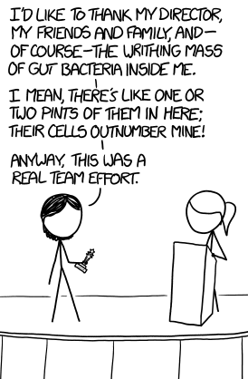


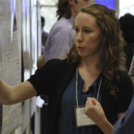



Acknowledgments
🐯
🐞
👽
Andrew
Fernandes
Jean
Macklaim
Vera Pawlowsky-Glahn
Juan Jose Egozcue
Justin Silverman
philr
Tom Quinn
propr
🐯
🐞
👽
Gregor Reid
Jeremy Burton
Amy McMillan
Daniel Giguere
Jia Rong Wu
Notes:
Many more fragments than we can count

